Slide 1
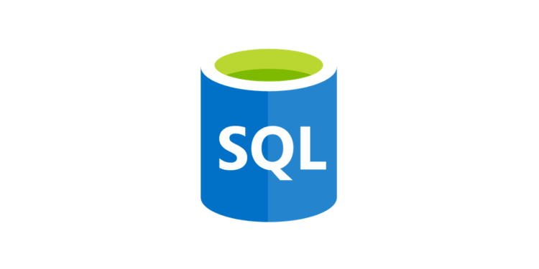
Transforming and Analyzing Data with SQL
Rodrigo Rezende

Slide 2
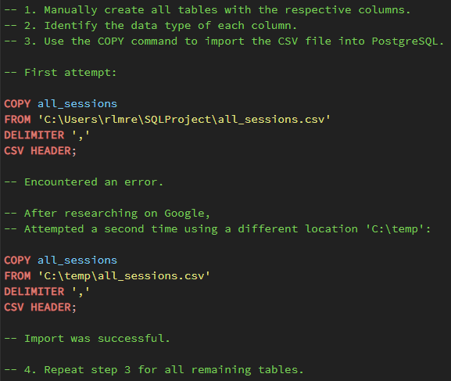
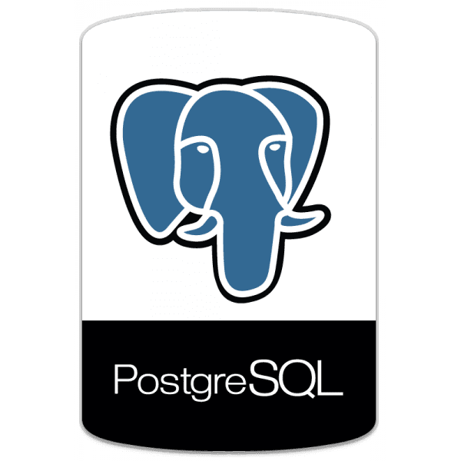
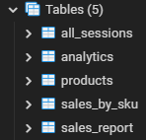
Import Process
Identify data types for each column.
Create tables in PostgreSQL with respective columns.
Import data from CSV files using COPY query.
Check and handle null values.
Validate imported data for integrity and consistency.

Slide 3
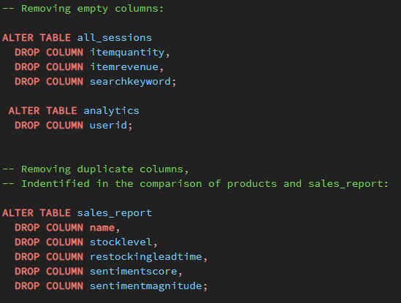
Cleaning
Removing empty columns using the DROP function.
Removing duplicate columns using the DROP function.
Changing the data type for better understanding.
The unit cost in the data needs to be divided by 1,000,000.

Slide 4
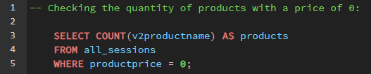

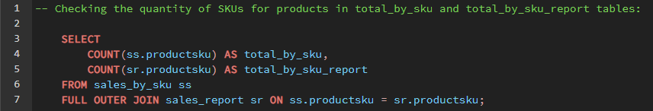

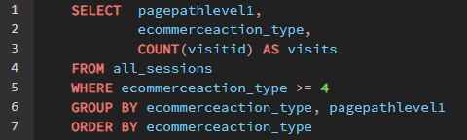
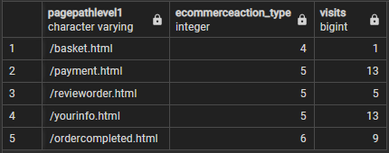
Challenges

Slide 5
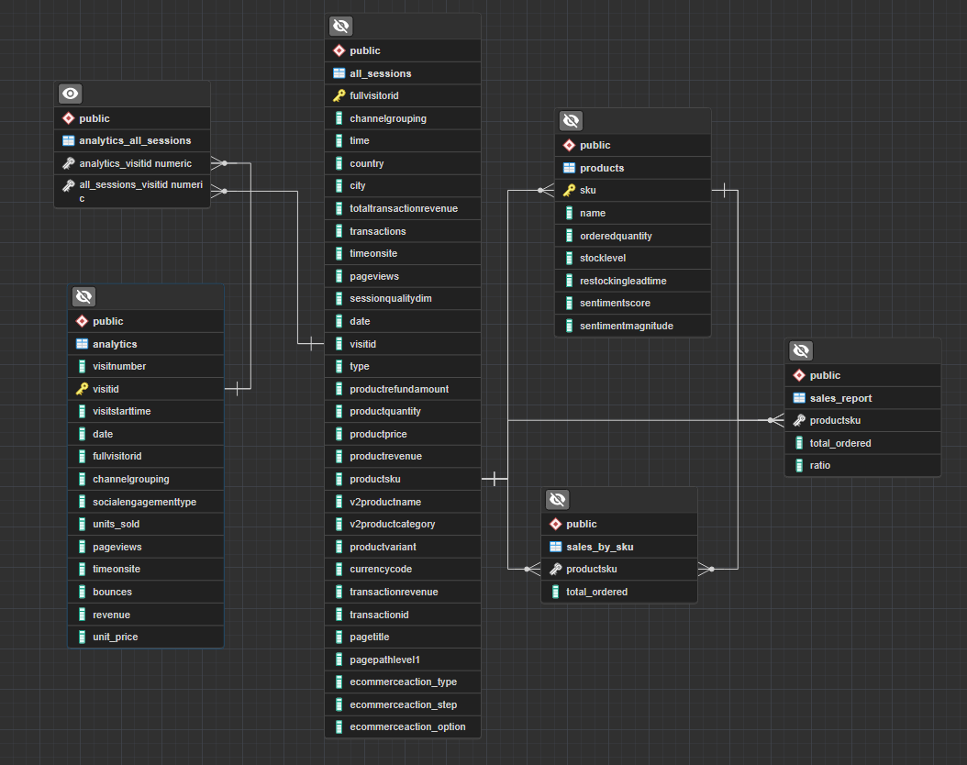
ERD

Slide 6
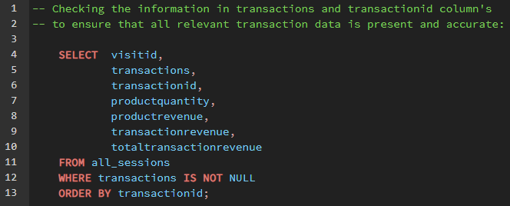
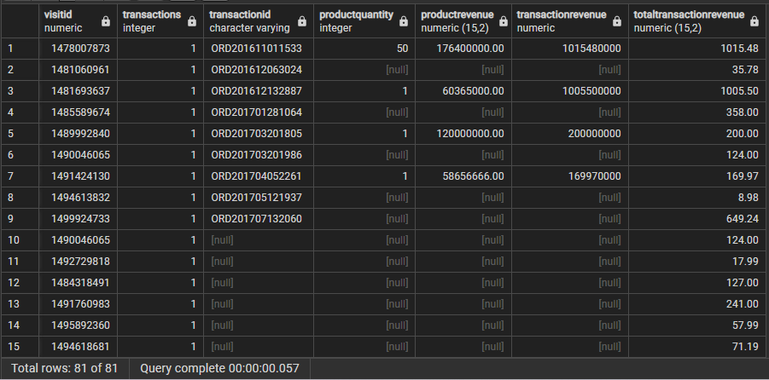
Data Quality Assurance Process

Slide 7
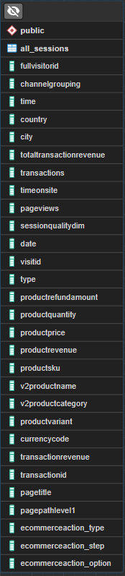
Future Goals
Fill in missing data to improve analysis.
Split data into more tables for efficiency.
Remove unnecessary data to further clean data.
Ensure data integrity and consistency for reliability.

